Slide 1
Star & Snowflake Schemas

Slide 2
What is Star Schema?
In the star schema design, a single object (the fact table) sits in the middle and is radially connected to other surrounding objects (dimension lookup tables) like a star.
Each dimension is represented as a single table.
The primary key in each dimension table is related to a foreign key in the fact table.

Slide 3
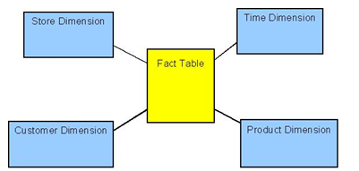
Example of Star Schema (Conceptual Model)

Slide 4
Example of Star Schema (Logical Model)
time
time_key
day
day_of_the_week
month
quarter
year
item
item_key
item_name
brand
type
supplier_type
Sales Fact Table
time_key
item_key
branch_key
branch
location
location_key
branch_key
branch_name
branch_type
location_key
street
city
province_or_street
country
units_sold
dollars_sold
avg_sales
Measures

Slide 5
What is Snowflake Schema?
The snowflake schema is an extension of the star schema, where each point of the star explodes into more points.
In a star schema, each dimension is represented by a single dimensional table, whereas in a snowflake schema, that dimensional table is normalized into multiple lookup tables, each representing a level in the dimensional hierarchy.

Slide 6
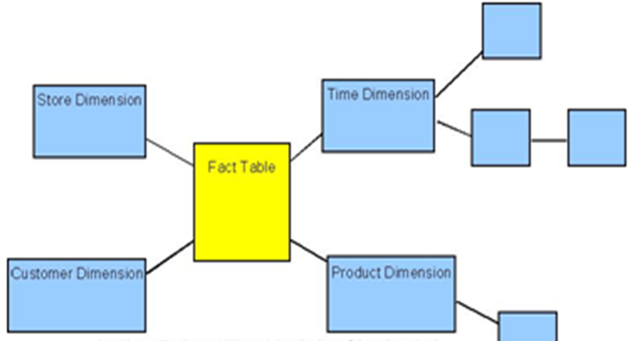
Example of Snowflake Schema (Conceptual Model)

Slide 7
Example of Snowflake Schema (Logical Model)
time
item
time_key
day
day_of_the_week
month
quarter
year
item_key
item_name
brand
type
supplier_key
supplier
Sales Fact Table
supplier_key
supplier_type
time_key
item_key
branch_key
branch
location
location_key
location_key
street
city_key
branch_key
branch_name
branch_type
units_sold
city
dollars_sold
city_key
city
province
country
avg_sales
Measures

Slide 8
Star Schema Vs
Snowflake Schema

Slide 9
1st point
Star schema consists of single fact table surrounded by some dimensional table.
In snowflake schema the dimension tables are connected with some sub dimension tables.

Slide 10
2nd point
Star Schema is De-Normalized.
Snowflake Schema is Normalized.

Slide 11
3rd point
In Star Schema there is no need of using JOINS to retrieve data within Dimension tables.
In Snowflake Schema JOINS are inevitable within Dimension tables.

Slide 12
4th point
In Star Schema the query processing time will be less resulting in less performance overhead.
In Snowflake Schema the query processing time will be more due to JOINS resulting in more performance overhead.

Slide 13
5th point
In a Star Schema a dimension table will not have any parent table.
In a Snowflake schema a dimension table will have one or more parent tables.

Slide 14
6th point
Hierarchies for the dimensions are stored in the dimensional table itself in Star Schema.
Hierarchies are broken into separate tables in snow flake schema. These hierarchies helps to drill down the data from topmost hierarchies to the lowermost hierarchies.

Slide 15
7th point
Star Schema is used for report generation.
Snowflake Schema is used for cube.

Slide 16
Summary
Star and snowflake schema designs are mechanisms to separate facts and dimensions into separate tables.
Snowflake schemas further separate the different levels of a hierarchy into separate tables.
In either schema design, each table is related to another table with a primary key/foreign key relationship.
Primary key/foreign key relationships are used in relational databases to define many-to-one relationships between tables.

